Slide 1
RL Project
Group 8:
Chia Dehan
Colin Jiang Kelin
Lim Wei Jie
Ng Juan Yong

Slide 2
Table of contents
01
02
03
Task 1 Approach
Task 1 Results
Task 2

Slide 3
01
Task 1 Approach

Slide 4
Algorithms
Models
Vanilla
SB3
Literature
QRDQN
TRPO
ARS
Recurrent PPO
Q-Learning Open Loop Monte Carlo Tree Search
Discrete
Continuous
TD Lambda
Rules Based
DQN

Slide 5
Vanilla
These models are built from James’ templates/by ourselves
They can be further categorized into discrete and continuous state spaces with discrete action spaces
Rules Based
TD Lambda
DQN

Slide 6
Vanilla
The Rules
If Tyre Condition < A
pit stop = True
If Weather is Dry
Choose 0
elif Wet% < B
Choose 1
elif Wet% < C
Choose 2
else
Choose 3
If Laps Cleared > D
Choose 4
Fixed weather sequence
rewards = []
For A in range(0,100):
For B in [20,40,60,80,100]:
For C in [20,40,60,80,100]:
For D in range(0,162):
g = 0
while not done:
…racing…
g += r
rewards.append(((A,B,C,D),g))
Rules Based
Rules are created to manage pit stop and tyre changing decisions
Thresholds A,B,C,D are tuned based on GridSearch

Slide 7
Vanilla
The Rules
If Tyre Condition < A
pit stop = True
If Weather is Dry
Choose 0
elif Wet% < B
Choose 1
elif Wet% < C
Choose 2
else
Choose 3
If Laps Cleared > D
Choose 4
Fixed weather sequence
num_episodes = 100
rewards = {}
For radius in range(625,1200,25):
radius_bin = radius // 50 - 12
For A in range(0,100):
For B in [20,40,60,80,100]:
For C in [20,40,60,80,100]:
For D in range(0,162):
For _ in num_episodes:
iteration_radius = radius + randint(0,49) - 25
g = 0
while not done:
…racing…
g += r
rewards[radius_bin].append(((A,B,C,D),g))
Rules Based
Rules are created to manage pit stop and tyre changing decisions
Different thresholds for different radius
Bin radius into intervals of 50; each interval will have its own thresholds
Thresholds A,B,C,D are tuned based on GridSearch
Evaluation via bootstrapping over 100 episodes for each radius bin

Slide 8
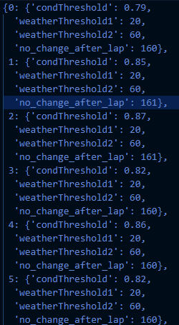
Vanilla
Best Rules
Each key-value pair corresponds to a radius-bin to best rules pair
For example:
0 : {
'condThreshold': 0.79, 'weatherThreshold1': 20, 'weatherThreshold2': 60, 'no_change_after_lap': 160
}
The key 0 refers to the first radius bin, which is radius in range of 600-649
The values is the rules the agent will follow corresponding to the radius
Rules Based
Rules are created to manage pit stop and tyre changing decisions
Different thresholds for different radius
Bin radius into intervals of 50; each interval will have its own thresholds

Slide 9
Vanilla
TD-Lambda
Tyre Condition, Radius, Laps Cleared, are discretized into bins
Models created for lambdas:
{0, 0.2, 0.4, 0.6, 0.8, 1.0}

Slide 10
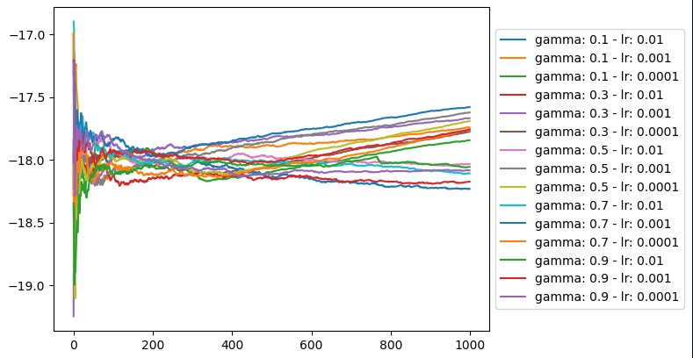
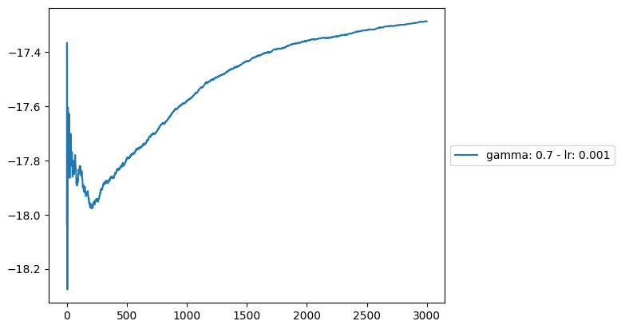
Vanilla
Hyper Parameter Tuning to find optimal gamma and learning rate
Evaluated using Cumulative Reward per Radius
DQN
Cumulative Reward per Radius continues to climb at 3000 episodes
However, evaluation results showed no signs of improvements after 2000 episodes
Tyre type, Weather Conditions, are one hot encoded
Hyper Parameter Tuning: Gamma, Learning Rate, Tau, Neurons
Decaying Epsilon for first 1000 episodes

Slide 11
SB3
These models utilizes Stable Baseline 3 environment wrappers
They are all using continuous state spaces and discrete action space
TRPO
ARS
Recurrent PPO
QRDQN

Slide 12
SB3
Discrete Actions
Continuous States
Car Tyres
Tyre type, Weather Conditions, are one hot encoded
Radius, Tyre Conditions, Laps Cleared are Floats

Slide 13
Literature
These models are adapted from research papers
Q-Learning Open Loop Planning
Reference:
Piccinotti, D., Likmeta, A., Brunello, N., & Restelli, M. (2021). Online planning for F1 race strategy identiﬁcation - github pages. Online Planning for F1 Race Strategy Identification. https://prl-theworkshop.github.io/prl2021/papers/PRL2021_paper_1.pdf
Journal: Association for the Advancement of Artificial Intelligence (AAAI), www.aaai.org

Slide 14
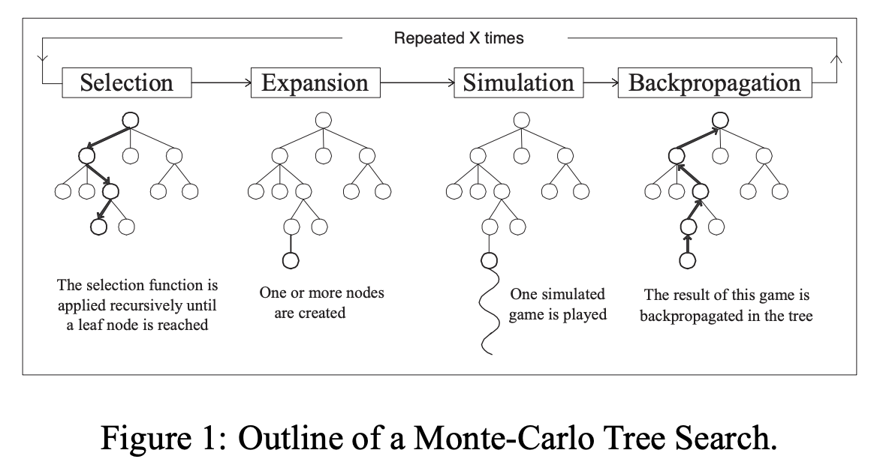
Literature
Q-Learning Open-Loop Planning (Monte Carlo Tree Search)
Open loop refers to doing MCTS at every lap.
In the backpropagation step, we update the Q-function.

Slide 15













Monte Carlo Tree Search
Step 1: At the ¾ mark of each lap: create root node
Step 2: Expand root node to all 5 unexplored children (i.e. 5 actions)
Step 3: For each child node, we rollout to the terminal state (i.e. 162 laps)
$$A_{0}$$
$$A_{4}$$
$$A_{0}$$
$$A_{4}$$
Root
Root
Root
$$S_{terminal}$$
$$S_{terminal}$$
$$A_{1}$$
$$A_{3}$$
$$A_{1}$$
$$A_{3}$$
$$A_{2}$$
$$S_{terminal}$$
$$A_{2}$$
$$S_{terminal}$$
$$S_{terminal}$$

Slide 16

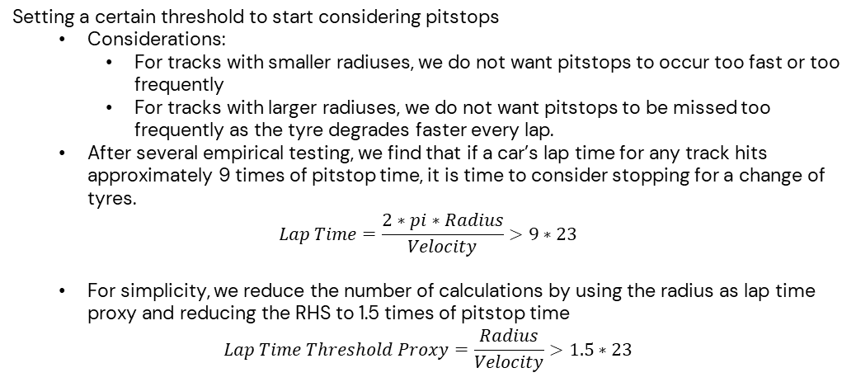


Rollout Policy – Determine Pitting Threshold
Pitstop Time = 23 seconds
Setting a certain threshold to start considering pitstops
Considerations:
For tracks with smaller radiuses, we do not want pitstops to occur too fast or too frequently
For tracks with larger radiuses, we do not want pitstops to be missed too frequently as the tyre degrades faster every lap.
After several empirical testing, we find that if a car’s lap time for any track hits approximately 9 times of pitstop time, it is time to consider stopping for a change of tyres.
$$Lap Time=\frac{2∗pi∗Radius}{Velocity}>9∗23$$
For simplicity, we reduce the number of calculations by using the radius as lap time proxy and reducing the RHS to 1.5 times of pitstop time
$$Lap Time Threshold Proxy=\frac{Radius}{Velocity}>1.5∗23$$
Race
Track
$$At ¾ of each lap:$$
Step 1: Calculate
$$Lap Time=\frac{Radius}{Velocity}$$
Step 2: Tune threshold
$$Lap Time=\frac{Radius}{Velocity}>1.5∗23$$

Slide 17
Rollout Policy – Greedy Epsilon Strategy to Account for Tyre-to-Weather Durability and Track Radius Factors
Step 1: Fix Specific Weather conditions that favors specific tyre types and set initial epsilon threshold
Next, we set a threshold for which tyres we should change to.
Based on intuition and empirical testing, these tyres are most suited to the following weather conditions.
#favourable weather for specific tyre
fav_weather_tyre = {
"Ultrasoft": ["Dry", "20% Wet"],
"Soft": ["20% Wet"],
"Intermediate": ["40% Wet", "60% Wet", "80% Wet"],
"Fullwet": ["80% Wet", "100% Wet"]
}
$$InitialEpsilonThreshold=curr_threshold=0.5$$

Slide 18
Rollout Policy – Greedy Epsilon Strategy to Account for Tyre-to-Weather Durability and Track Radius Factors
Step 2: Account for Track Radius by Adjusting linearly
The intuition here is that
longer tracks will require more immediate changing of tyres as the next time to pit might be a lot longer later.
Shorter tracks will have a lower probability to change tyres even if weather is unfavorable as the next time to change tyres is only a short while later.
If weather is favorable to current tyre type:
Decrease epsilon threshold linearly by factoring in track radius.
curr_threshold -= (0.45 * (1-(curr_state[-2]-600)/600))
If weather is unfavorable to current tyre type:
Increase epsilon threshold linearly by factoring in track radius.
curr_threshold += (0.45 * (1-(curr_state[-2]/600)-1))
Note here that radius = curr_state[-2]

Slide 19
Rollout Policy – Greedy Epsilon Strategy to Account for Tyre-to-Weather Durability and Track Radius Factors
The intuition here is that
longer tracks will require more immediate changing of tyres as the next time to pit might be a lot longer later.
Shorter tracks will have a lower probability to change tyres even if weather is unfavorable as the next time to change tyres is only a short while later.
Step 3: Determine Tyres
epsilon_for_change = random.random()
if epsilon_for_change <= curr_threshold:
doTyreSelection()
Else:
doNothing

Slide 20
Rollout Policy – Tyre Selection
To choose which tyres to fit on, we focus on the durability factor of the tyre in all race conditions.
possible_tyres = ["Ultrasoft", "Soft", "Intermediate", "Fullwet"]
possible_weather = ["Dry", "20% Wet", "40% Wet", "60% Wet", "80% Wet", "100% Wet"]
for radius in range(600, 1250, 50):
for weather in possible_weather:
doMeasurement()
The durability factor is measured by:
Lap at which tyres reach close to 0 for a specific constant weather
Linear rate of deceleration across time: (velocities[0]-velocities[-1])/lap_count
We weigh the 2 subfactors equally to get the most durable tyre compound for a specific radius and specific weather condition.

Slide 21
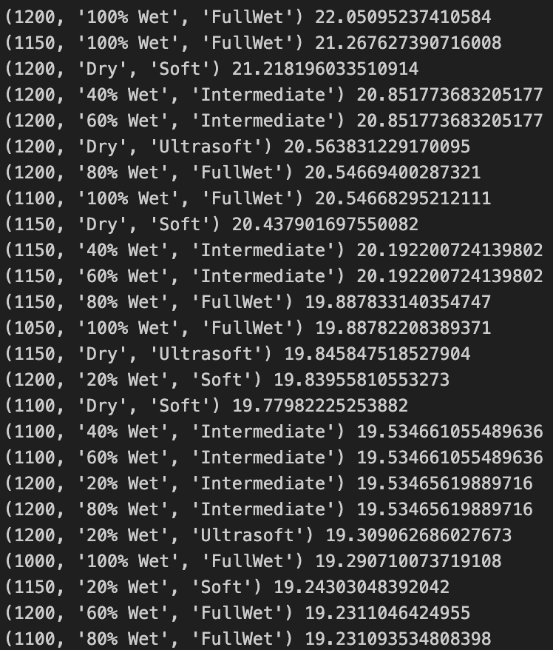
Rollout Policy – Tyre Selection
The durability factor is measured by:
Lap at which tyres reach close to 0 for a specific constant weather
Linear rate of deceleration across time: (velocities[0]-velocities[-1])/lap_count
We weigh the 2 subfactors equally to get the most durable tyre compound for a specific radius and specific weather condition.
Top 25 most durable tyre compounds across various radius and weather conditions.

Slide 22
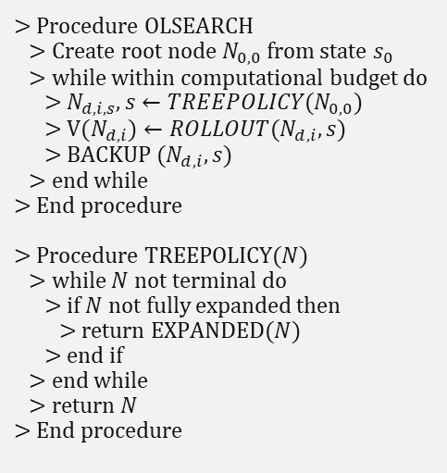
Pseudo Code of our Rigorously Flexible Q-Learning Open Loop Planning
> Procedure OLSEARCH
> Create root node $N_{0,0}$ from state $s_{0}$
> while within computational budget do
> $N_{d,i,s},s←TREEPOLICY(N_{0,0}$)
> $V(N_{d,i})←ROLLOUT(N_{d,i},s$)
> $BACKUP (N_{d,i},s$)
> end while
> End procedure
> Procedure TREEPOLICY($N$)
> while $N$ not terminal do
> if $N$ not fully expanded then
> return EXPANDED($N$)
> end if
> end while
> return $N$
> End procedure
At each lap, we create a root node.
We then expand the root node to its unexplored actions and subsequent states.
Thereafter, we do a rollout to terminal state based on the previously discussed rollout policy.
The backup function computes the Q value which represents the expected returns based on the rollout strategy.

Slide 23
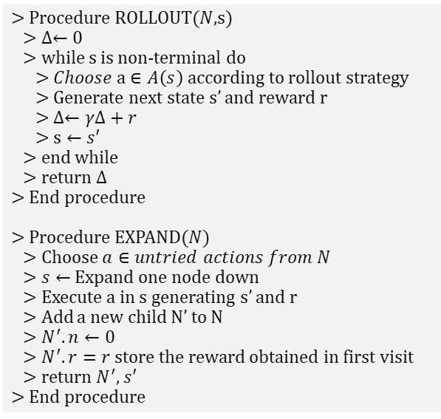
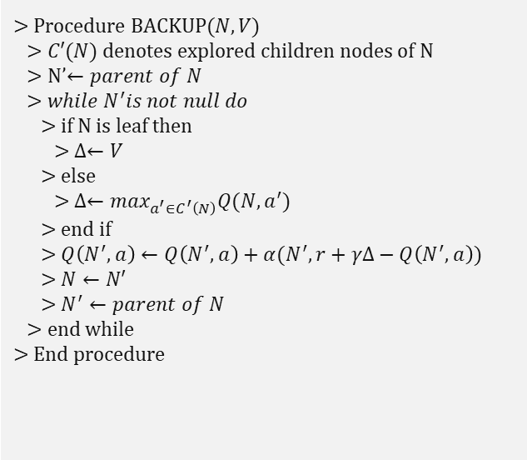
Pseudo Code of our Rigorously Flexible Q-Learning Open Loop Planning
> Procedure ROLLOUT($N$,s)
> $∆←0$
> while s is non-terminal do
> $Choose a∈A\left(s\right)$ according to rollout strategy
> Generate next state s’ and reward r
> $∆←γ∆+r$
> $s←s′$
> end while
> return $∆$
> End procedure
> Procedure EXPAND($N$)
> Choose $a∈untried actions from N$
> $s←$ Expand one node down
> Execute a in s generating s’ and r
> Add a new child N’ to N
> $N^{′}.n←0$
> $N^{′}.r=r$ store the reward obtained in first visit
> return $N^{′},s′$
> End procedure
> Procedure BACKUP($N,V)$
> $C′(N)$ denotes explored children nodes of N
> N’$←parent of N$
> $while N^{′}is not null do$
> if N is leaf then
> $∆←V$
> else
> $∆←\max_{a^{′}∈C^{′}\left(N\right)}Q(N,a^{′})$
> end if
> $Q\left(N^{′},a\right)←Q\left(N^{′},a\right)+α(N^{′},r+γΔ−Q\left(N^{′},a\right))$
> $N←N′$
> $N^{′}←parent of N$
> end while
> End procedure

Slide 24
Final Selection – Combined Returns
#for shorter races, we want fewer pitstops, so we look more at future rewards
self.weight_future_q = ((1-(state[-2]-600)/600))
We take the maximum of long-term Q-value and the short-term immediate reward of taking the next action.
The weightage again takes into consideration of track radius. A smaller track radius would want fewer pitstops taken, thus we weigh Q-values, a longer-term view, more than immediate rewards.
if self.weight_future_q <= 0.25:
self.weight_future_q = 0.15
elif self.weight_future_q > 0.25 and self.weight_future_q <= 0.75:
self.weight_future_q = 0.35
We do a further clipping of the weightage of future q-values.
We find that as track radius get larger, the decay in the importance of future q-values is exponential but smooths eventually to an asymptote. Thus, we try to replicate the exponential decay to an asymptote with a clipping function as shown above.

Slide 25
02
Task 1 Results

Slide 26
Evaluation method
Dry
3 fixed weather trajectories over 13 radius for evaluation:
Linear upwards 2. Linear downwards 3. Flat oscillating
42 test trajectories with more frequent and random weather changes
(20+ changes per race)
20% Wet
(3 * 13)
+
42
=
81 weather configurations
40% Wet
60% Wet
Legend
80% Wet
100% Wet
Radius: xxx
START
Radius: xxx
END
Radius: xxx
Laps
0
20
40
60
80
100
120
140
162

Slide 27
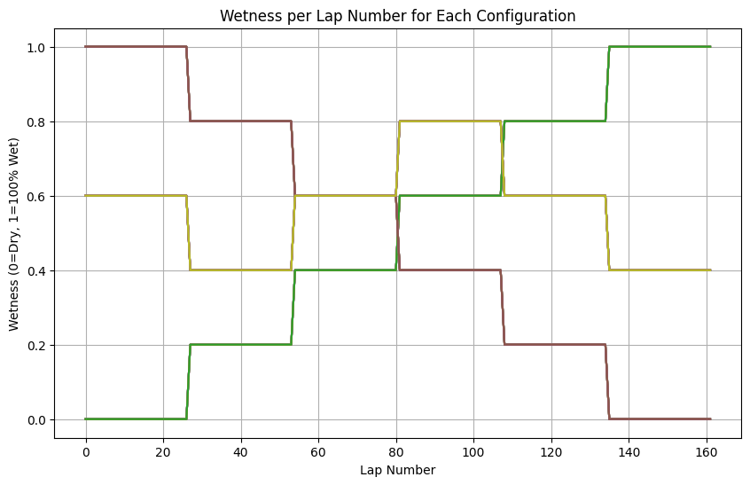
Evaluation method
3 fixed weather trajectories

Slide 28
Results – Top Models
*Not real results – For illustration only
Weather Sequence | MCTS | DQN | Rules Based
0 | -11100.7 | -11092.2 | …
1 | -11831.2 | -11815 | …
2 | -12522.1 | -12548.8 | …
3 | -13259.2 | -13228.3 | …
… | … | … | …
… | … | … | …
78 | -15340.1 | -15384.9 | …
79 | -15994.8 | -16008.6 | …
80 | -16697.5 | -16696.3 | …
81 | -17380.9 | -17409.4 | …
We find our top model by summing the count of weather sequence which the model scored highest in
The top 3 models are:
Open loop (monte carlo tree search)
DQN (vanilla)
Rules Based

Slide 29
Results – Top Models
Models | Number of wins out of 81 weather configs
DQN | 21
Rulesbased | 32
Open loop MCTS | 28
RulesBased outperforms other 2 models
Also shows more consistent results
This chart demonstrates the consistency of RulesBased approach. Lower Normalized Score = Higher Rewards

Slide 30
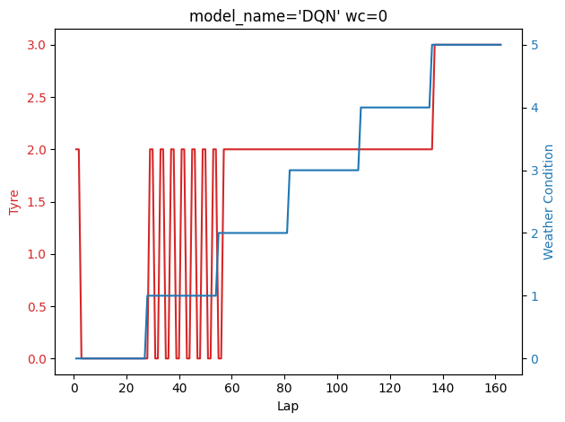
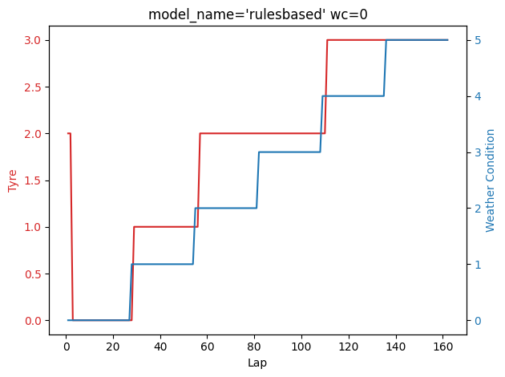
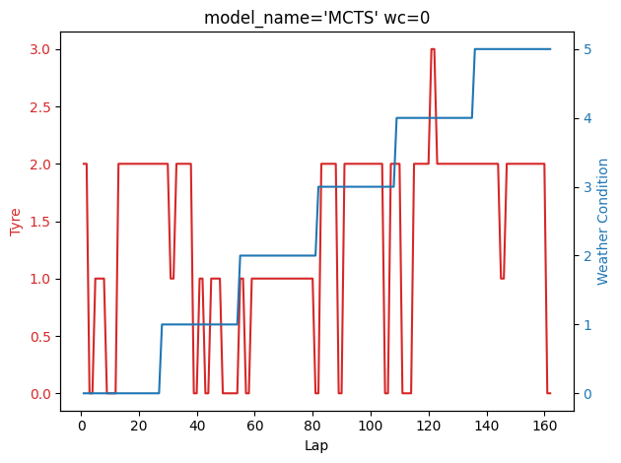
Model Behaviour: WC=0
The six weather states:
0. Dry (eg. sunny day)
1. 20% Wet (eg. drizzle which just started)
2. 40% Wet
3. 60% Wet
4. 80% Wet
5`. 100% Wet (eg. heavy rain)
The four possible tyre choices:
0. Ultrasoft
1. Soft
2. Intermediate
3. Fullwet
Notable behavior
Rulesbased will act immediately after valid weather changes
DQN shows heavy oscillation but is similar to rulesbased behaviour.
MCTS behaviour erratic but seems to react appropriately to weather changes
Model | Reward
DQN | -11102
Rules-based | -11093
MCTS | -11087

Slide 31
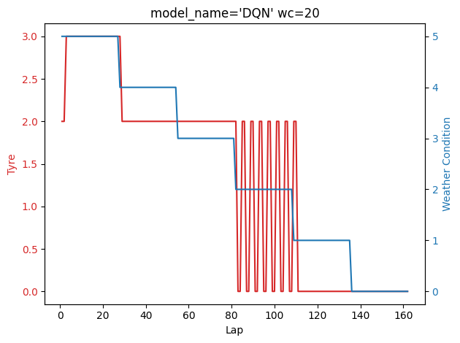
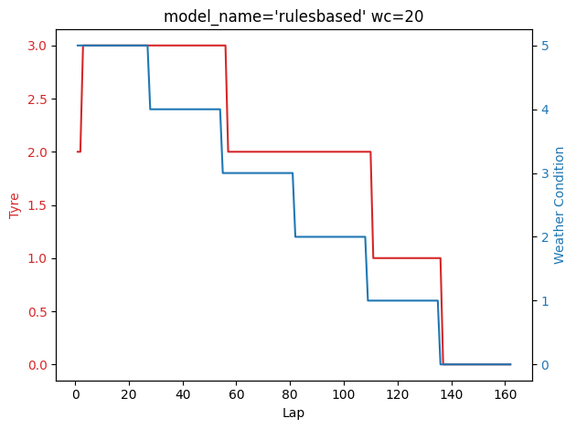
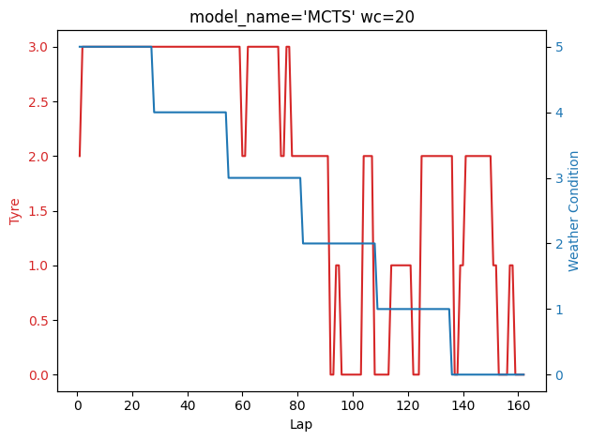
Model Behaviour: WC=20
The six weather states:
0. Dry (eg. sunny day)
1. 20% Wet (eg. drizzle which just started)
2. 40% Wet
3. 60% Wet
4. 80% Wet
5`. 100% Wet (eg. heavy rain)
The four possible tyre choices:
0. Ultrasoft
1. Soft
2. Intermediate
3. Fullwet
Notable behavior
Rulesbased will act immediately after valid weather changes
DQN shows heavy oscillation but is similar to rulesbased behaviour.
MCTS behaviour erratic but seems to react appropriately to weather changes
Model | Reward
DQN | -16009
Rules-based | -16007
MCTS | -16014

Slide 32
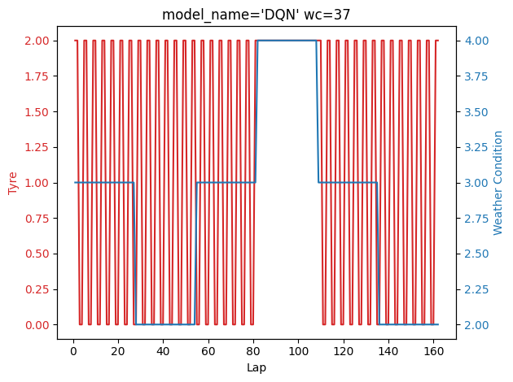
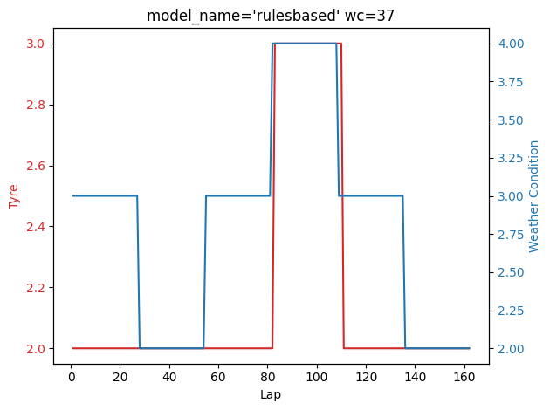
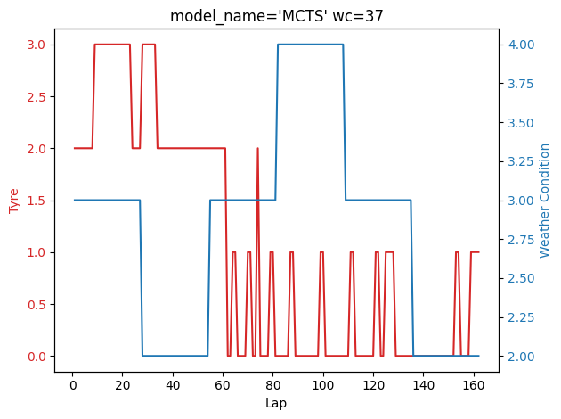
Model Behaviour: WC=37
The six weather states:
0. Dry (eg. sunny day)
1. 20% Wet (eg. drizzle which just started)
2. 40% Wet
3. 60% Wet
4. 80% Wet
5`. 100% Wet (eg. heavy rain)
The four possible tyre choices:
0. Ultrasoft
1. Soft
2. Intermediate
3. Fullwet
Notable behavior
Rulesbased responds to 60% Wet weather condition
DQN shows heavy oscillation in tyres, which is hard to interpret.
MCTS takes a different tyre trajectory compared to rulesbased, using all 4 tyre types.
Model | Reward
DQN | -18770
Rules-based | -18694
MCTS | -18588

Slide 33
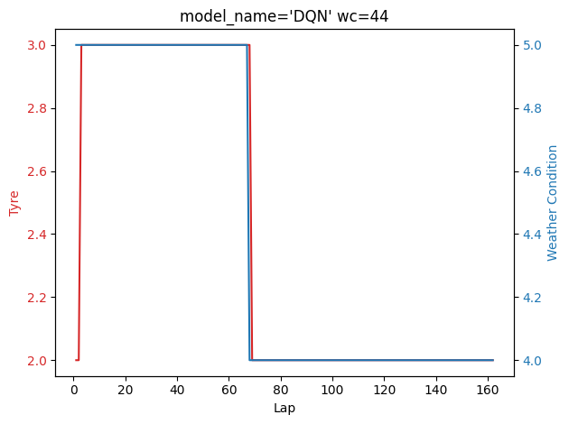
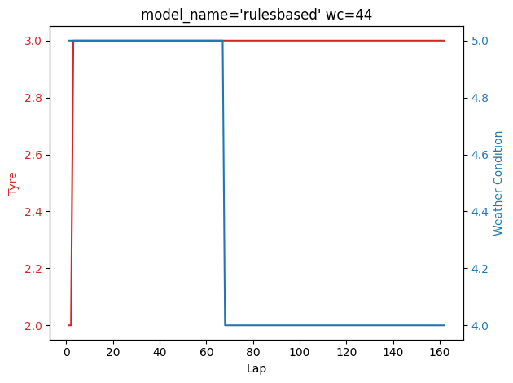
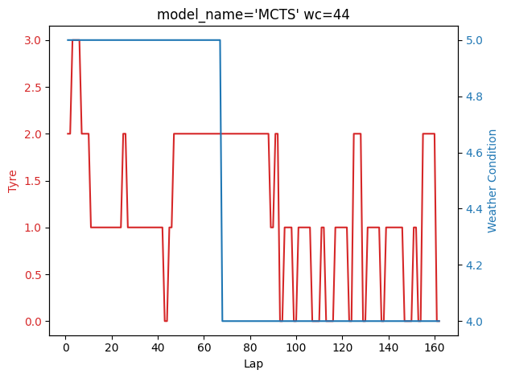
Model Behaviour: WC=44
The six weather states:
0. Dry (eg. sunny day)
1. 20% Wet (eg. drizzle which just started)
2. 40% Wet
3. 60% Wet
4. 80% Wet
5`. 100% Wet (eg. heavy rain)
The four possible tyre choices:
0. Ultrasoft
1. Soft
2. Intermediate
3. Fullwet
Notable behavior
Rulesbased chooses a constant tyre
DQN similar to rulesbased, but changes tyre to Intermediate upon weather change.
MCTS takes a different tyre trajectory compared to rulesbased, using all 4 tyre types.
Model | Reward
DQN | -11139
Rules-based | -11128
MCTS | -11078

Slide 34
03
Task 2

Slide 35
Key Addition
Multiple Racers – each aiming for best race ranking
Rewards based on lap position
Option to drive recklessly or conservatively, but risk getting into an accident
Each Racer follows different behaviors

Slide 36
Multi-Agent?
Not Really. Racers take action based on Lap ranking, but not on other Racers’ actions

Slide 37
Additonal Elements
Driving style
Complexity
Accidents
Reckless or Conservative driving styles.
Driving recklessly increases chances of accidents
Track complexity.
Higher complexity increases probability of accidents
Accident = Game Over

Slide 38
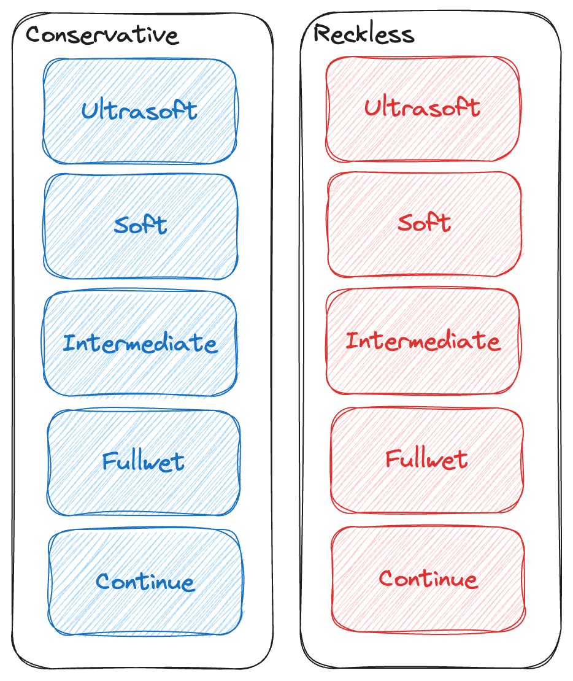
Action Space

Slide 39
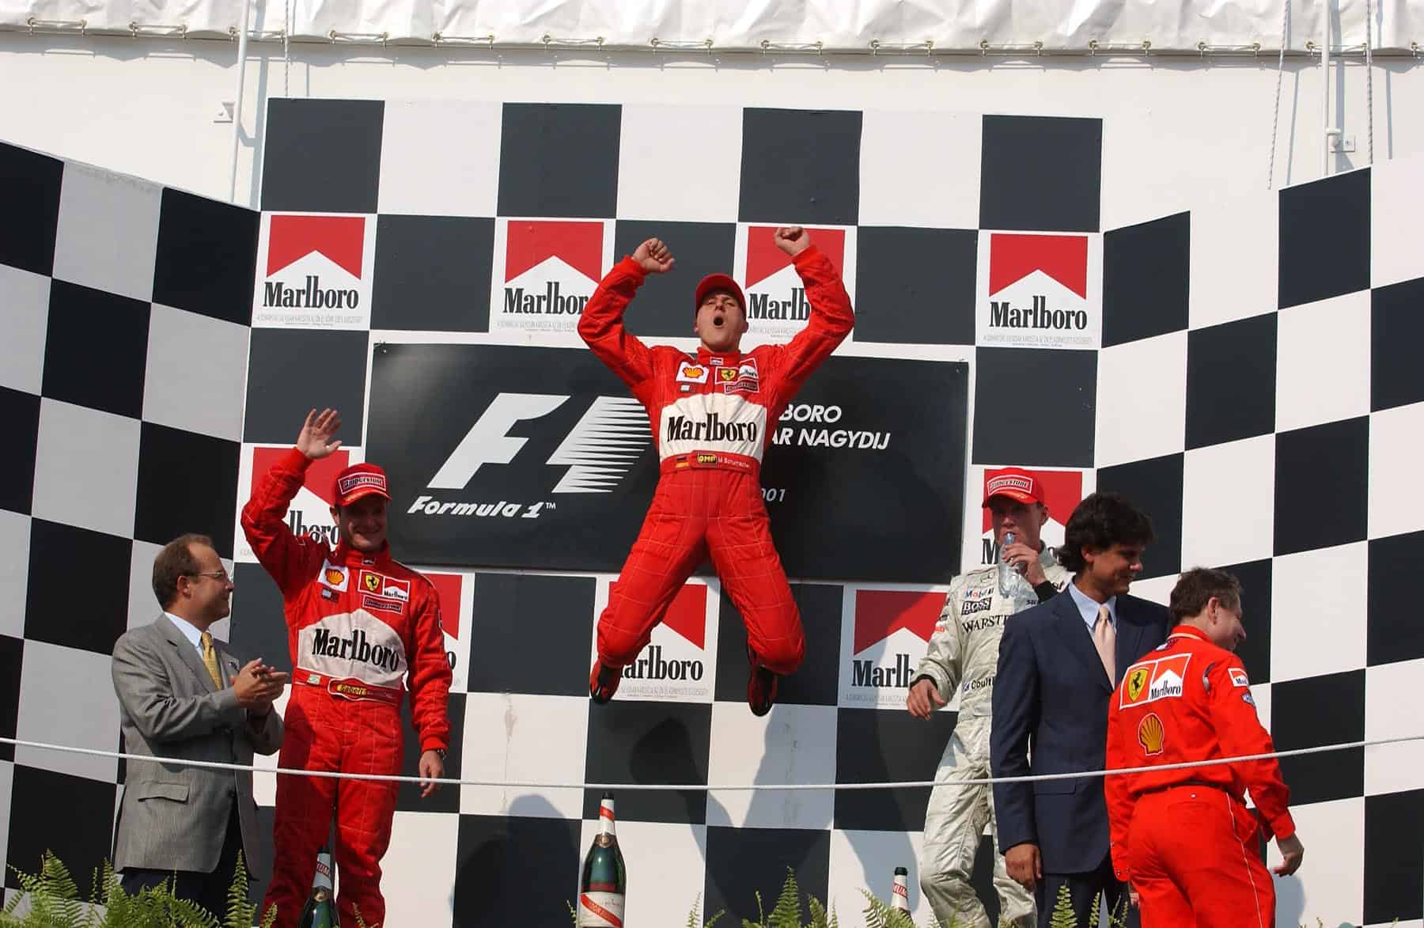
Rewards

Slide 40
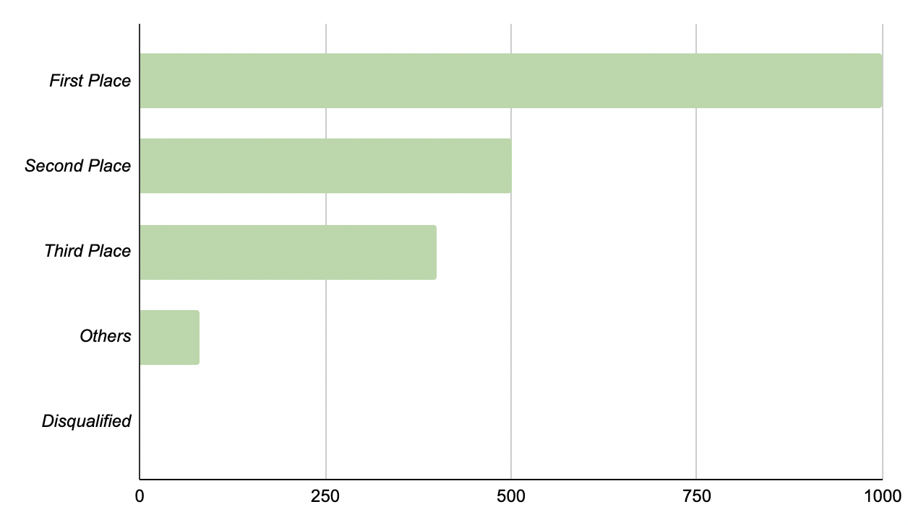
Rewards
Decreasing reward for lower placing.
Same rewards for placing fourth and below.
Zero reward for not completing the race.

Slide 41
Algorithms
Models
Multiple Models
Probabilistic
SB3
Split models
Stack models
DQN from Task 1
DQN

Slide 42
Probabilistic Models
Risk Level
α
A1
Agents with higher risk level has a higher probability to adopt a reckless driving style for a specific lap.
Agent
1 - α
Reckless counterpart of A1​

Slide 43
Multiple Models
Split Models
Model A
Pitstop action
One model determines the pitstop action, while the other determines the driving style to be adopted.
Resulting action
Model B
Driving style

Slide 44
Multiple Models
Stack Models
One model determines the pitstop action and the other determines resulting action by taking the model's output into account.
Pitstop action
Model A
Model B
Driving style + pitstop action

Slide 45
Evaluation method
Participants
Rounds
Accident Rates
10 participants – probabilistic models (p = [0, 0.5]), DQN, split models and stack models.
50 races for each complexity level of 0, 0.5 and 1.0.
Conservative - 0%
Reckless - 1.5% to 3.0%

Slide 46
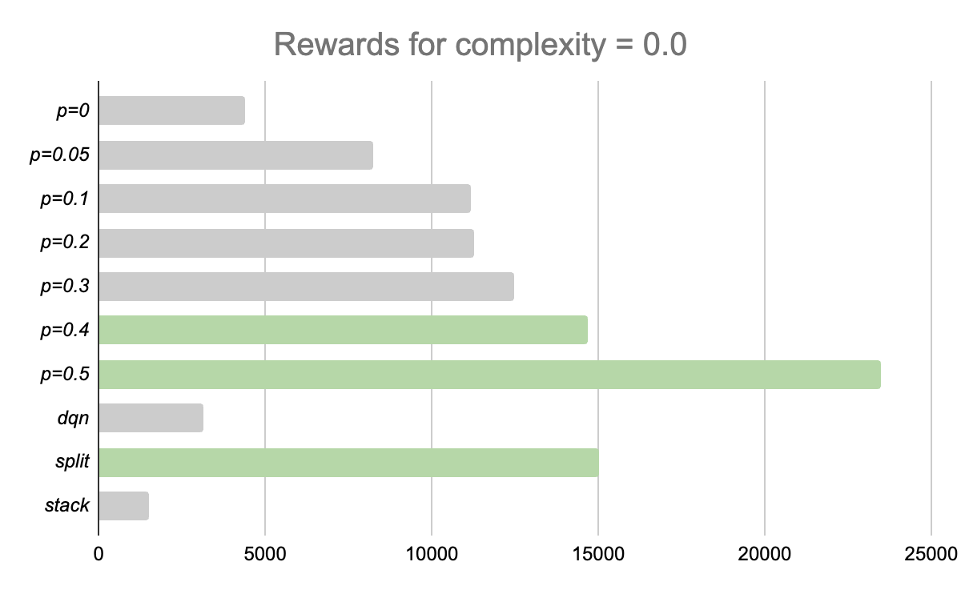
Results

Slide 47
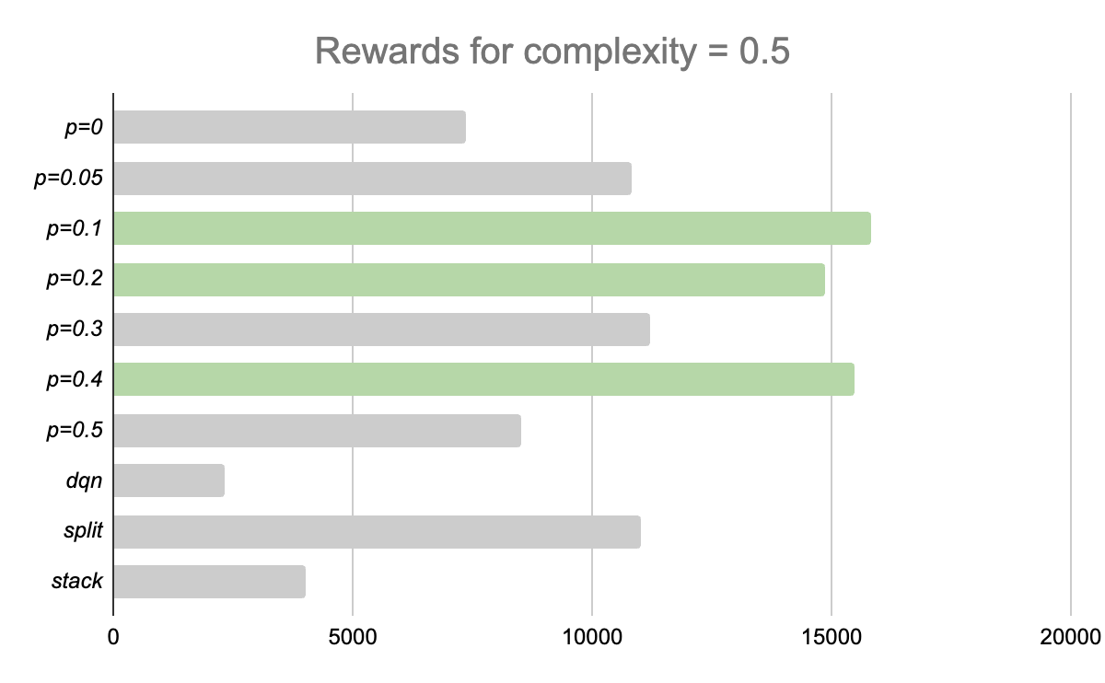
Results

Slide 48
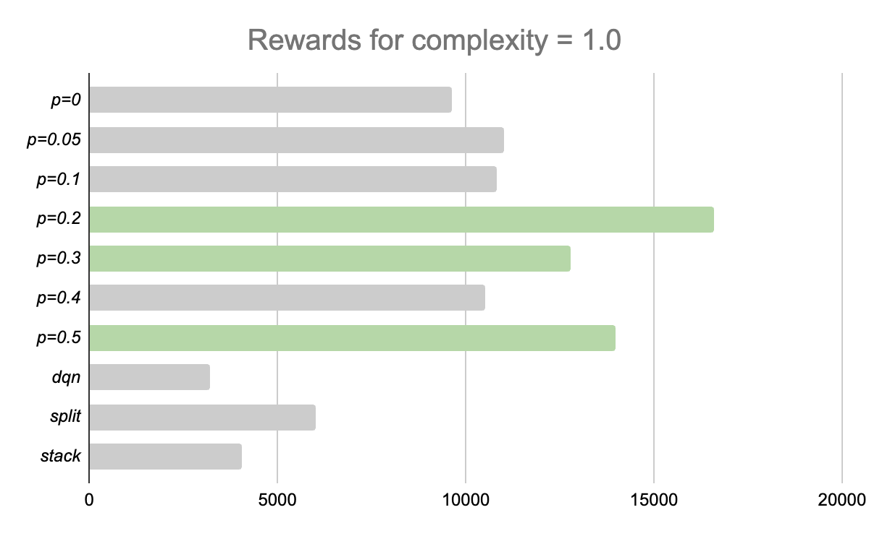
Results

Slide 49
Thanks!
Do you have any questions?
Please keep this slide for attribution

Slide 50
Evaluation Test Set Curation
42 Test Trajectories with more frequent weather changes: (approx. 20 or more weather changes per race)
Radius (m)
600
700
800
900
1000
1100
1200
Weather Condition
Dry
20% Wet
40% Wet
60% Wet
80% Wet
100% Wet
Tyre Type
Intermediate
Random Weather Sequence

Slide 51
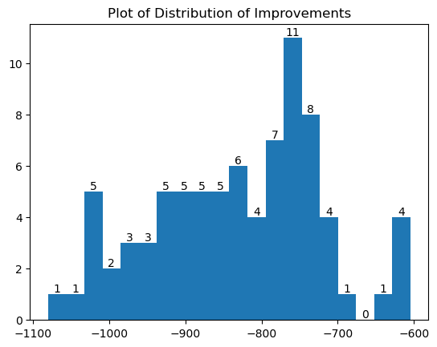
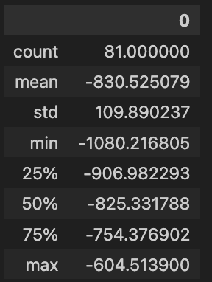
Results
From the above histogram plot, generally, we can visualize what is the distribution of improvement that RF-QLOP Planning achieves over the single-action agent.
Our model is able to reduce the race time with a median of 825 seconds across all types of conditions with a constraint of radius from 600m to 1200m.
We can see that distribution is slightly skewed to the right and has the most occurrences of race time reduction by 750 seconds to 775 seconds.

Slide 52
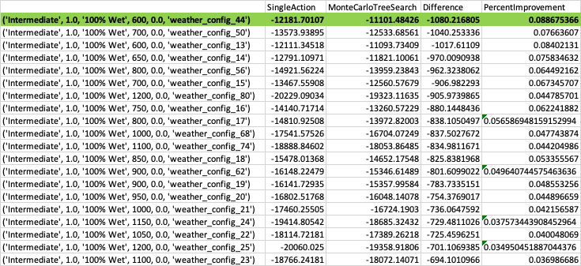
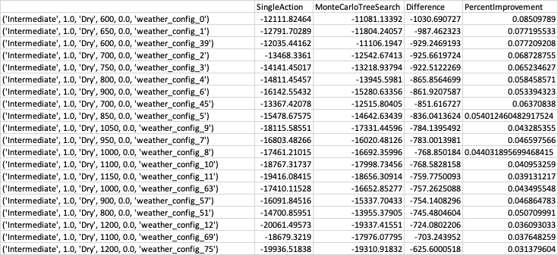
Results
From the breakdown in the above diagram, we can see that the model is generalizable across all types of weathers.
Does better in more distinct weather types, such as Dry or 100% Wet conditions.
As radius increases, performance drops.

Slide 53
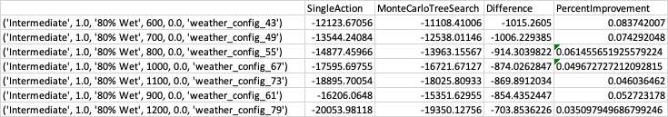
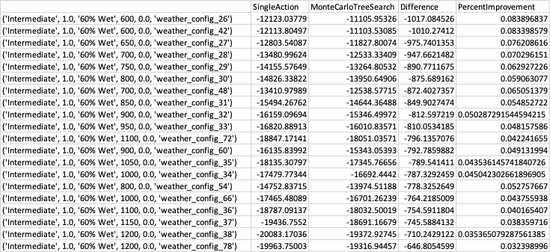
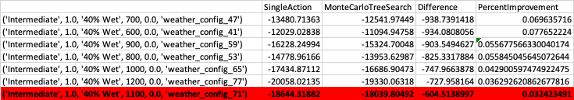
Results
In less distinct weather condition, we also see more variance in model performance.

Slide 54
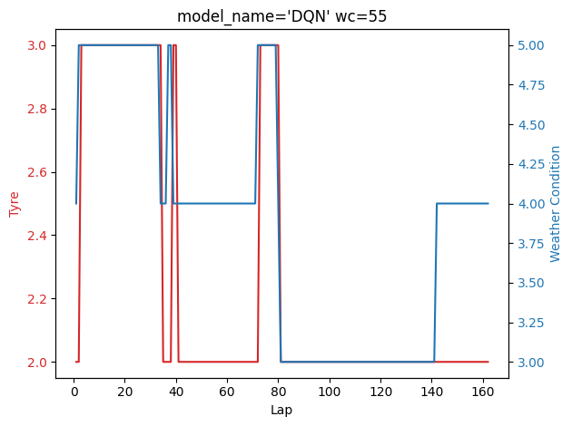
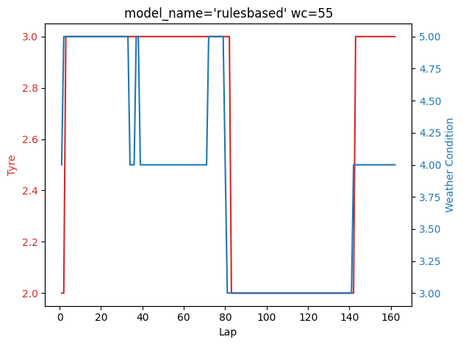
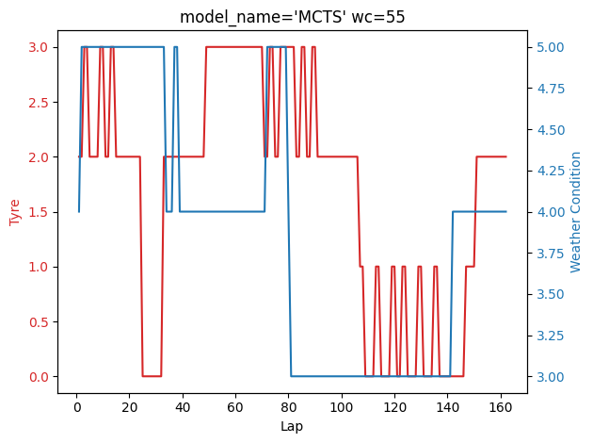
Model Behaviour: WC=55
The six weather states:
1. Dry (eg. sunny day)
2. 20% Wet (eg. drizzle which just started)
3. 40% Wet
4. 60% Wet
5. 80% Wet
6. 100% Wet (eg. heavy rain)
The four possible tyre choices:
1. Ultrasoft
2. Soft
3. Intermediate
4. Fullwet
Notable behavior
1.
Model | Reward
DQN | -13984
Rules-based | -13976
MCTS | -13950

Slide 55
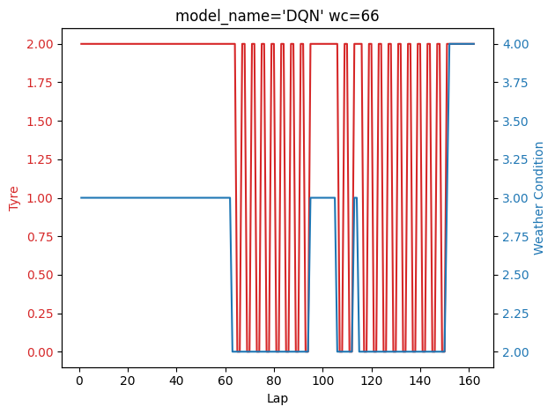
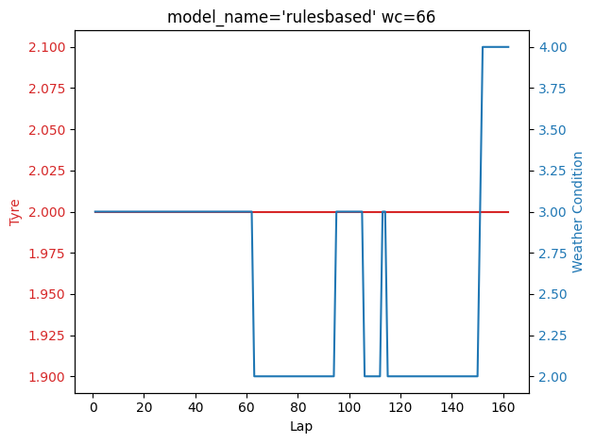
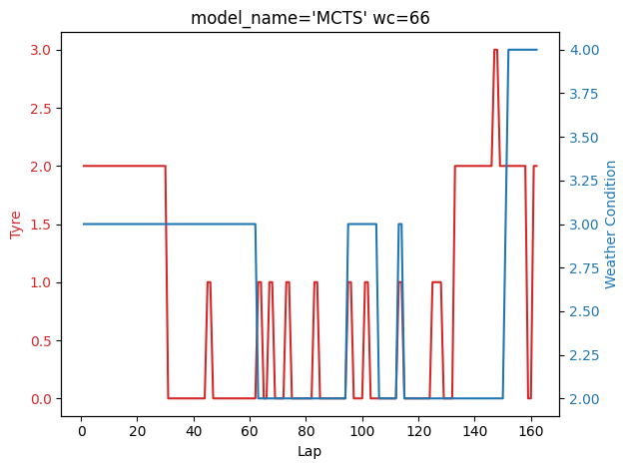
Model Behaviour: WC=66
The six weather states:
1. Dry (eg. sunny day)
2. 20% Wet (eg. drizzle which just started)
3. 40% Wet
4. 60% Wet
5. 80% Wet
6. 100% Wet (eg. heavy rain)
The four possible tyre choices:
1. Ultrasoft
2. Soft
3. Intermediate
4. Fullwet
Notable behavior
DQN shows heavy oscilation when weather is 20% wet, faces uncertainty of a weather transition
Rulesbased constant tyre
Model | Reward
DQN | -16715
Rules-based | -16692
MCTS | -16618

